Slide 1
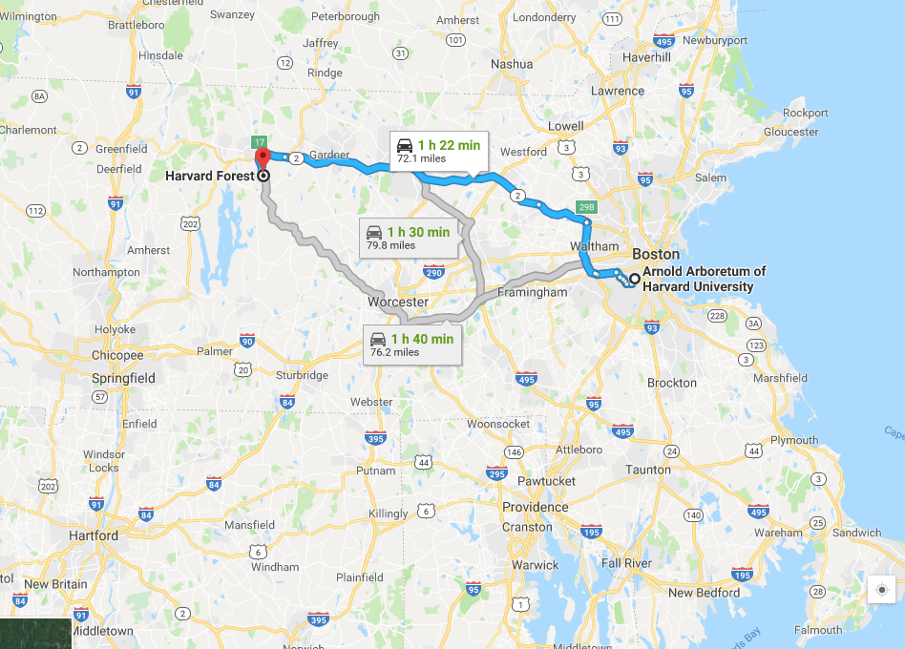
Study Question:

Slide 2
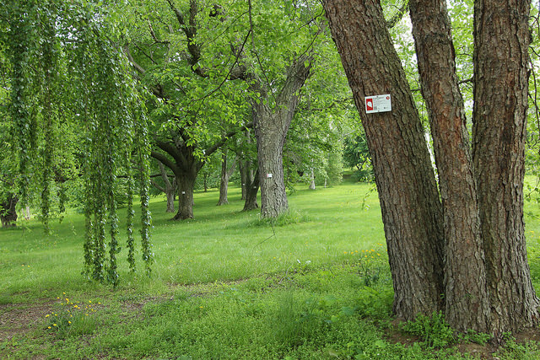
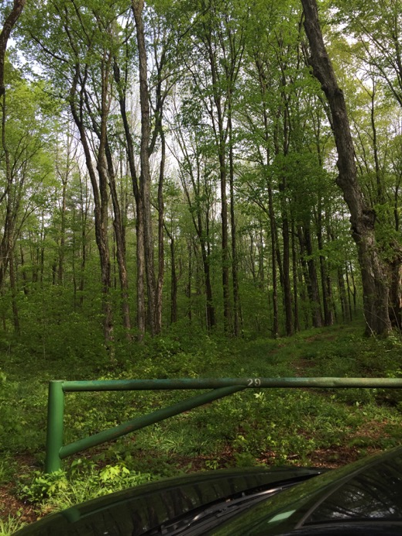
HARVARD FOREST
ARNOLD ARBORETUM

Slide 3
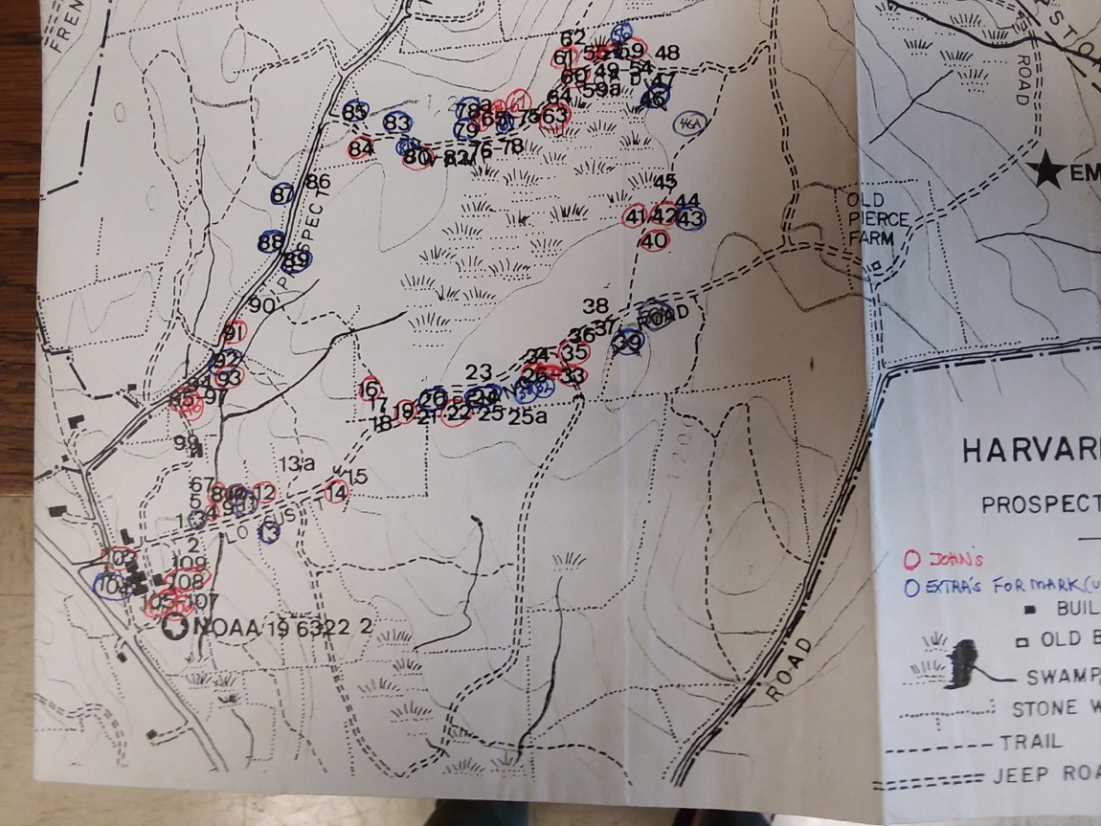

Slide 4
APPROACH 1:
How do GDDs to leafout compare between hobo logger data and weather station data?
And how do these compare across sites?
GDDs ~ 1 + (1|species)
y_{i} ~ N(μ_{i}, σ)
y_{i} = ⍺_{I} + σ

Slide 5
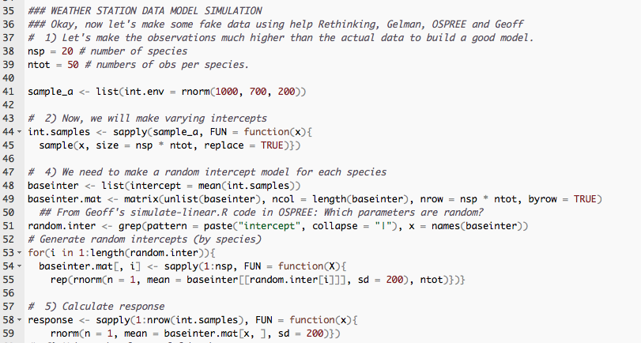

Slide 6
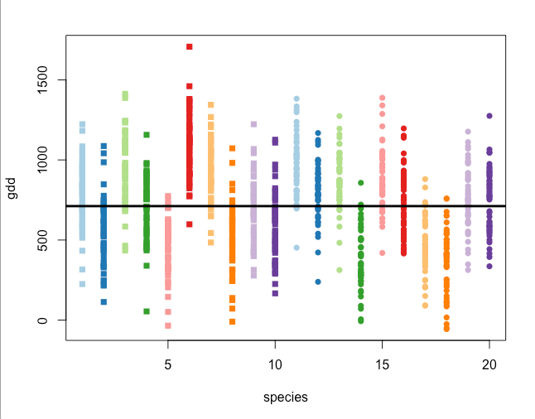
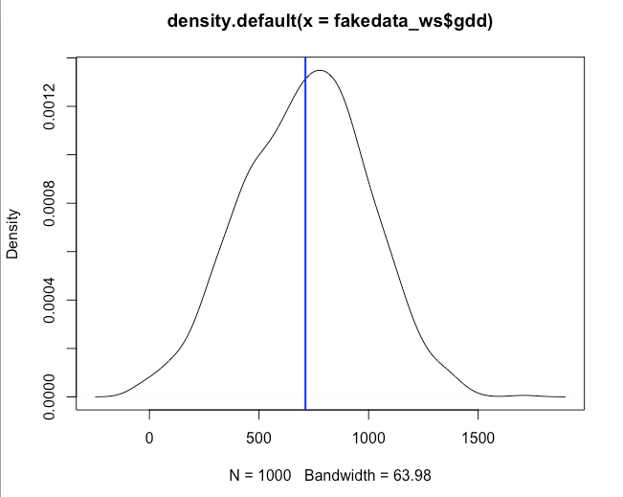

Slide 7
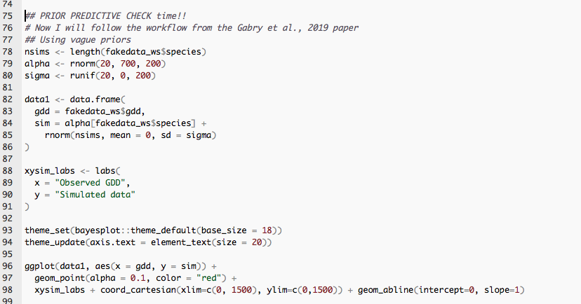
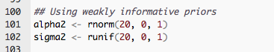

Slide 8
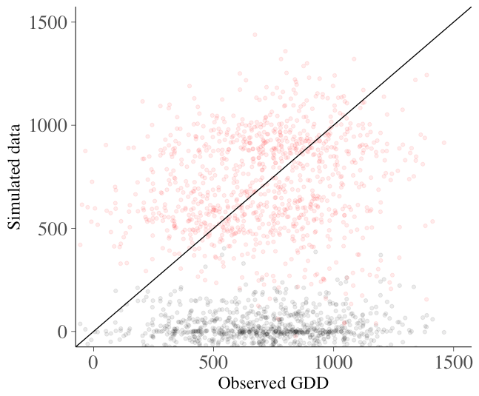
Red = vague priors
Black = weakly informative
Weather Station Data

Slide 9
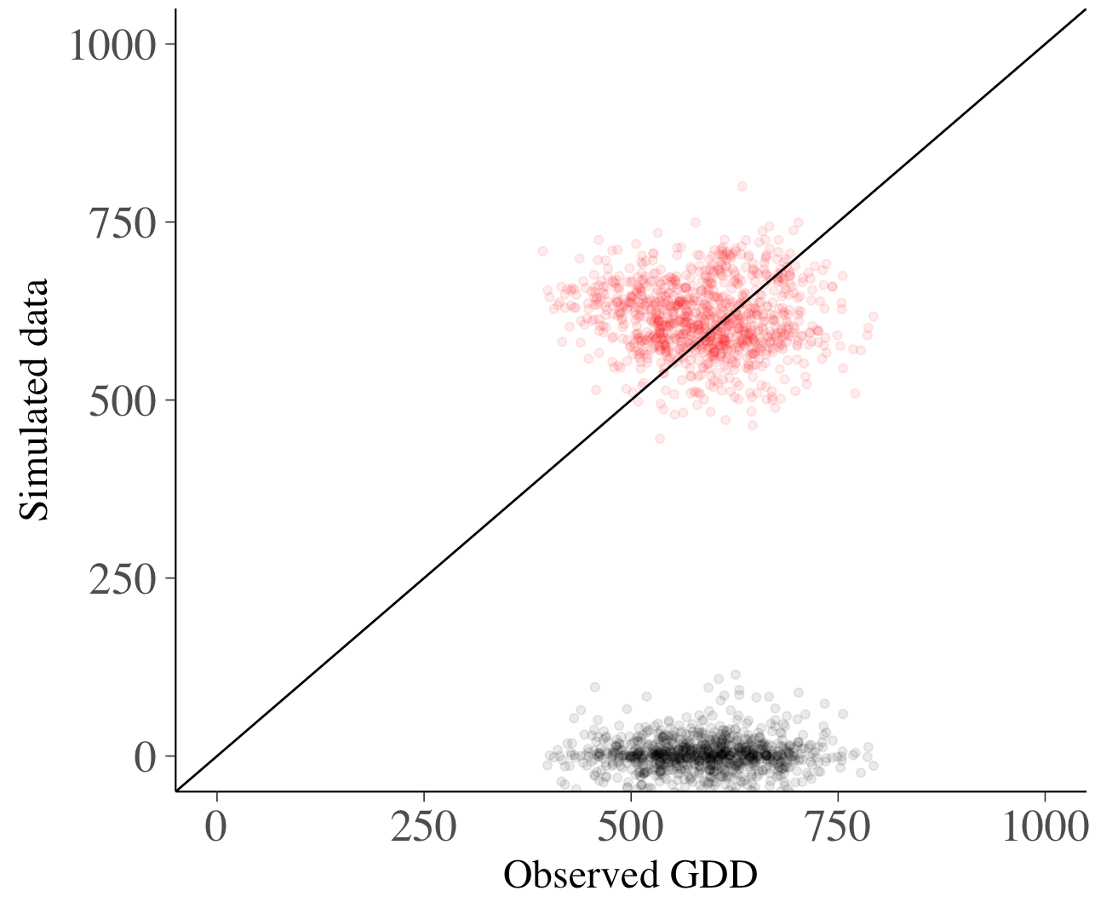
Hobo Logger Data
Red = vague priors
Black = weakly informative

Slide 10
APPROACH 2:
Let’s try and see if there’s an `urban’ effect by combining sites into one model.
Again compare weather station data to hobo logger data in separate models
GDDlo ~ urban + (urban|species)
y_{i} ~ N(μ_{i}, σ)
y_{i} = ⍺_{I} + βx _{I} + σ

Slide 11
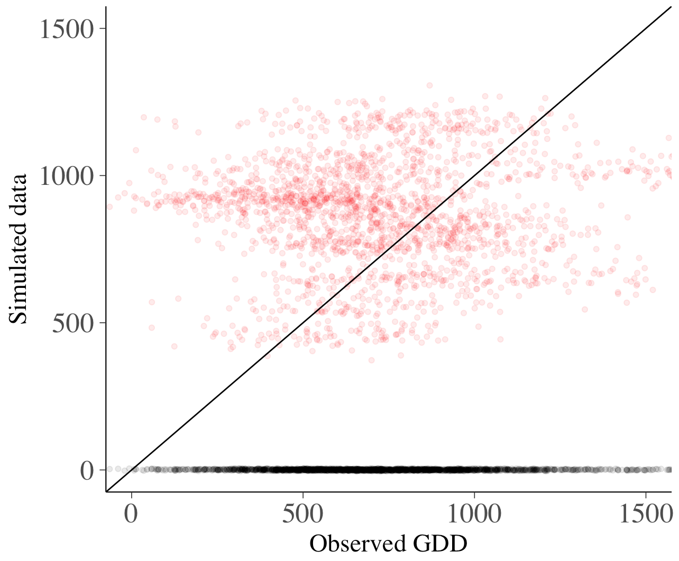
Weather Station Data
Red = vague priors
Black = weakly informative

Slide 12
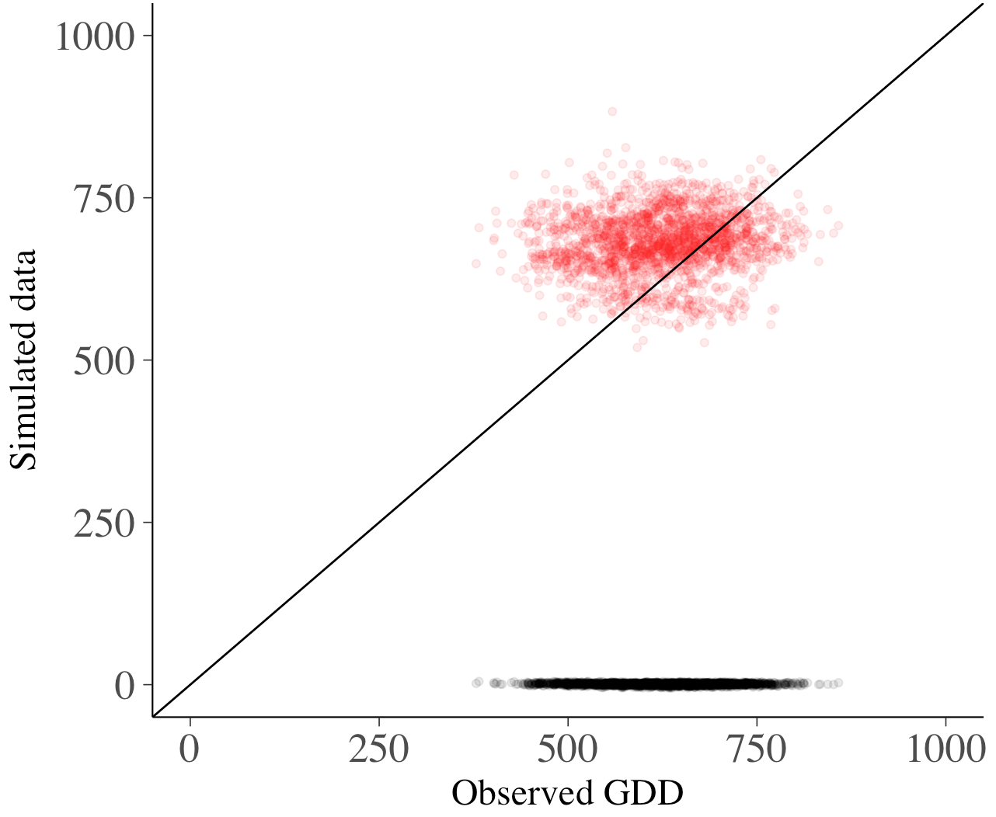
Hobo Logger Data
Red = vague priors
Black = weakly informative

